Slide 1
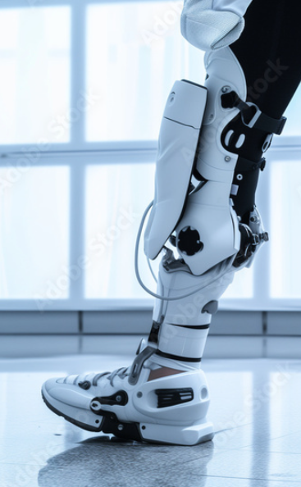

NextStep
A Machine Learning Approach for Prosthesis Control
[A]
Liam Bloomfield, Benjy Bream, Luke Clark, Matthew Halewood. Alastair Kirkwood
Notes:
Script guidance: Hi, we are NextStep, and this presentation is on designing a machine learning approach to predict prosthesis control

Slide 2
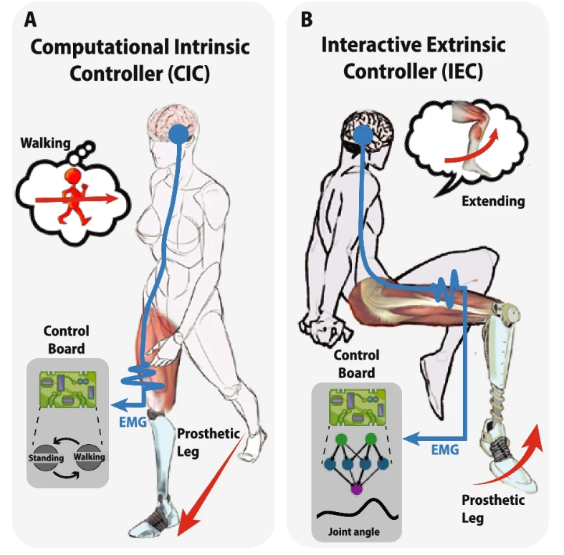
Where will this be used in prosthetics?
Current Prosthetics:
Adjusts joints reactively, causing delays
Brain Electrode based sensors
Our solution:
Use Machine Learning to classify locomotion from sensory data
Predict ankle motion, to allow for a more natural gait
See [6], [C]
Notes:
Current prosthetic limbs rely on reactive control, using sensors to adjust movement only after detecting changes—a limiting and unnatural approach. While brain-computer interfaces (BCIs) promise direct neural control, their invasive nature keeps them confined to labs.
We propose a safer solution: predictive prosthetics. Building on gait classification research done by Berning et al 2021, our model aims to anticipates movement: enabling seamless, natural motion. Instead of reacting, your prosthetic ankle "knows" what’s coming. When successful we will be able to validate current research and set the way for engineers to develop the first commerically viable robotic prosthetics.

Slide 3
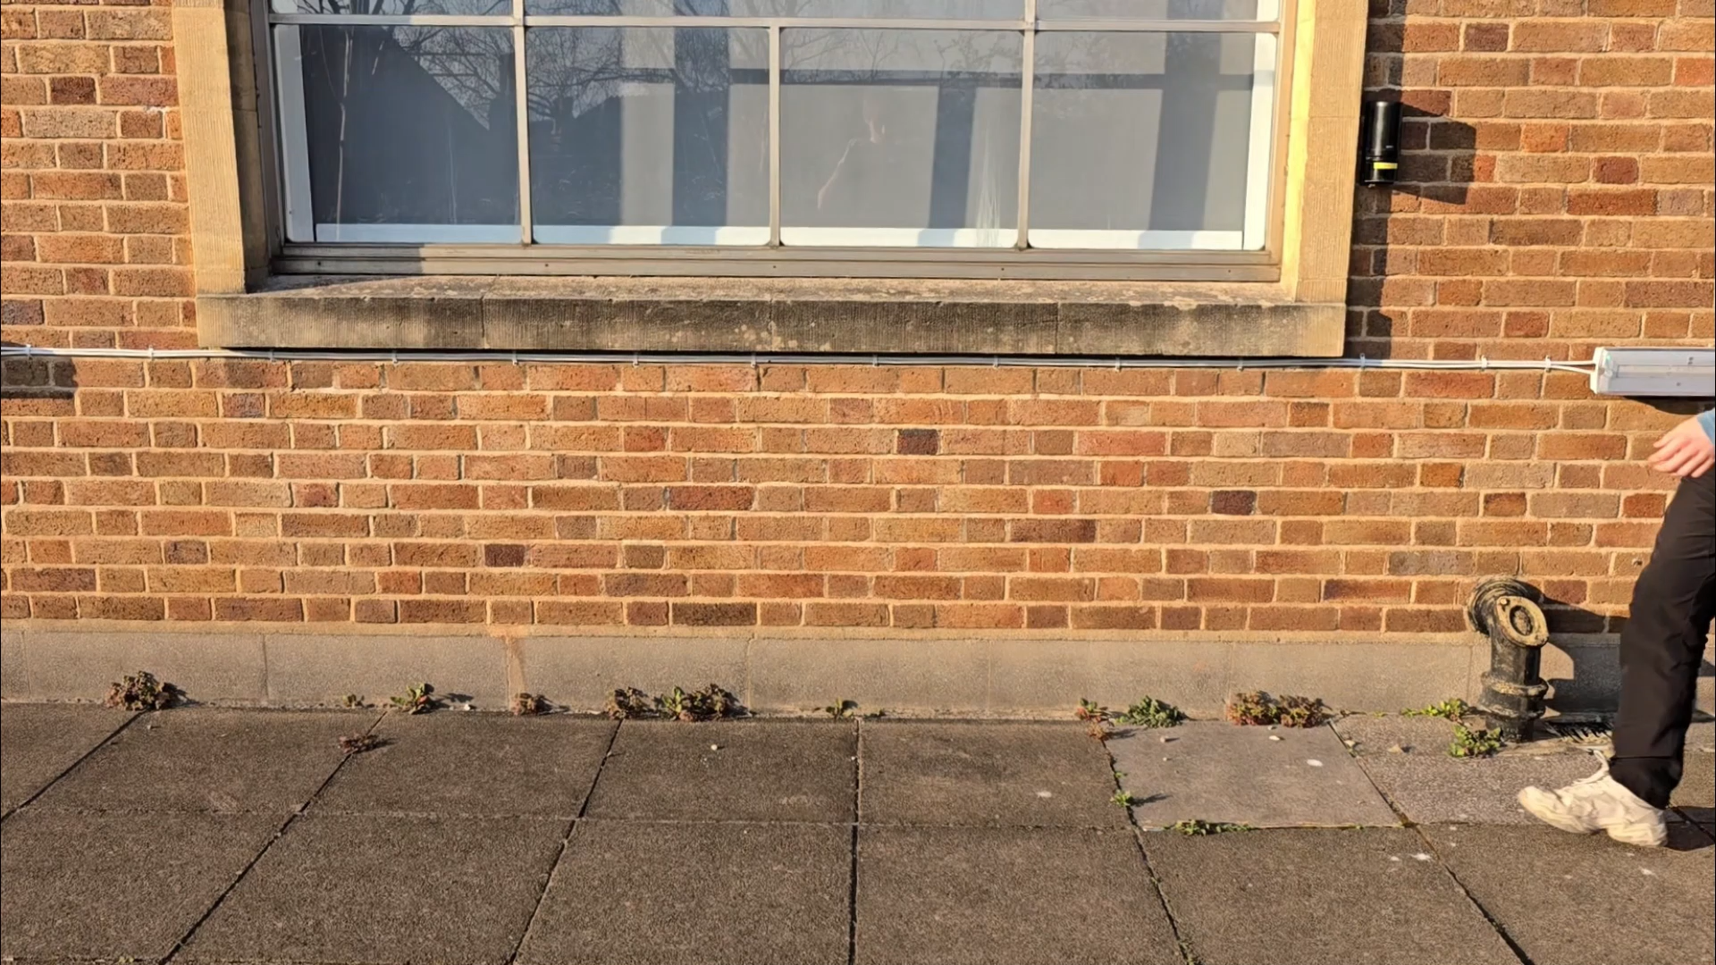
The Gait Cycle
Notes:
Script guidance: A normal gait consists of two phases, a stance phase and a swing phase. These can then be divided up into further subphases such as heel strike, toe-off and midstance. For the purpose of analysis a complete cycle is defined to be when a leg completes its second heel strike.
https://www.physio-pedia.com/The_Gait_Cycle
Explain Gait cycle with video (should be spoken over and annotated video)
Other talking points: People with prosthethic legs struggle to learn to walk and its extra effort and worse mobility
Technology has advanced enough to allow for robotic prosthetics to start to become viable which will improve moment
Machine learning could create personalised(???) and predictive inputs to the leg which will make walking more fluid and promote independence
// Develop a way to reliably classify and predict gait so it can be used by motorised prosthetics to aid with movement
Robotic prosthetics are becoming more prevalent
It can improve the functionality and effectiveness of new prosthetics
It can address issues like falls and misalignment
It can potentially provide more customised and responsive prosthetic control
//

Slide 4
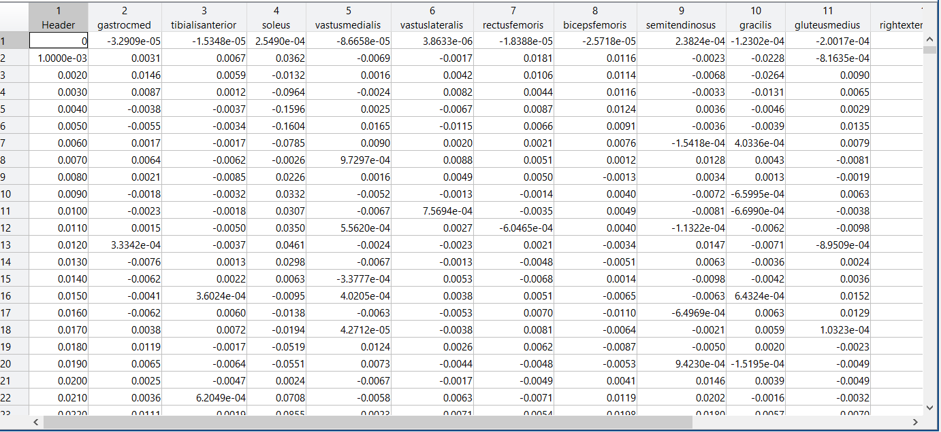
Gait Dataset
Total Data
Example of EMG data
Muscle
5 different sensor types
N total readings
4 locomotion modes
22 total subjects
Time steps(s)
EMG values
Dataset provided by Carmargo et al in the Journal of Biomechanics [10]
Notes:
Script guidance: The dataset provided comprehensive sensor coverage, spanning from each subject's torso down to their feet. However, requiring a person to wear sensors across their entire body is impractical. Instead, it is more reasonable to focus on a specific region. This project concentrates on data from sensors in the thigh region, utilising five EMG sensors, a goniometer measuring the knee’s angle, and an IMU capturing acceleration across different planes of motion in the thigh.

Slide 5
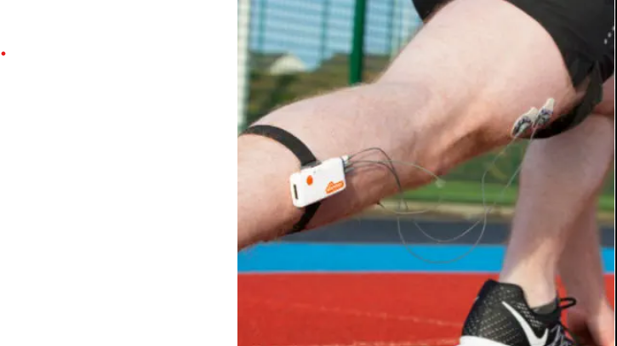
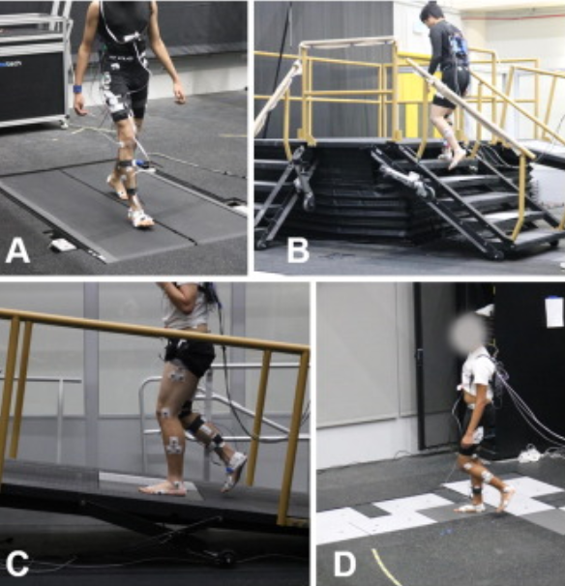
Variables
Variables
Chosen Control Subject:
AB14
Sensors used:
Ambulation modes chosen for comparison:
Level-ground(walk)
Ascent/Descent: Ramp, Stair
EMG
GON
IMU
Ambulation modes chosen for comparison:​
Walk ​
Ramp ascent/descent​
Stair ascent/descent​
Chosen subject for test data:​
AB14 (greatest variation in height compared to the mean height of all subjects)​
Sensors used:​
EMG data (only from the thighs, simulating data from a prosthetic user wearing a sleeve over the thigh)​
Potentially an accelerometer in the thigh​
[E]
Notes:
Script guidance: For the ambulation modes we selected all but the treadmill data, as it’s gait features overlapped with the level-ground walking. To reduce bias and help validate the final models a control subject was picked based on which subject had the greatest variation in height to the mean – selecting AB14. Then for the sensors, EMG, IMUs and Goniometer’s were chosen

Slide 6
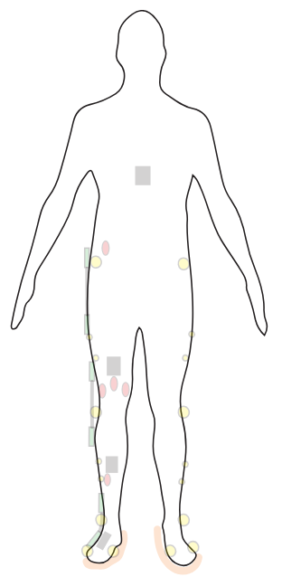
Chosen Features
Inertial Measurement Unit(IMU)
Goniometer(GON)
EMG data
Notes:
These diagrams present the bodily locations of the Goniometers, IMU, and EMG sensors. Prosthesis which would use the data in this setup would be transtibial amputations. ~25seconds

Slide 7
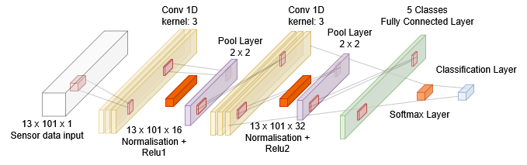
Base CNN Classification Model
Based upon Fricke C et al. research into using ML to classify EMG patterns in gait disorders
Uses Convolutional layers to extract features
Learns to recognise patterns from the same ambulation mode
Notes:
Based on Fricke C et al.'s research evaluating three machine learning algorithms for classifying EMG patterns in gait disorders, CNN was chosen as the base model due to its superior accuracy among the tested methods. Although the data exhibited varying amplitude over time, effectively making it two-dimensional, processing it sequentially allowed a 1D CNN model to be effective. CNNs utilize convolutional layers to extract features, enabling the model to identify patterns and accurately recognize different ambulation modes. Since gait cycles are periodic, repeating the same motion, distinct patterns should emerge from the data. The CNN model can leverage these recurring patterns to accurately classify the corresponding ambulation mode. ~40seconds

Slide 8
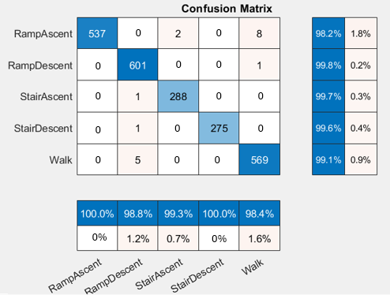
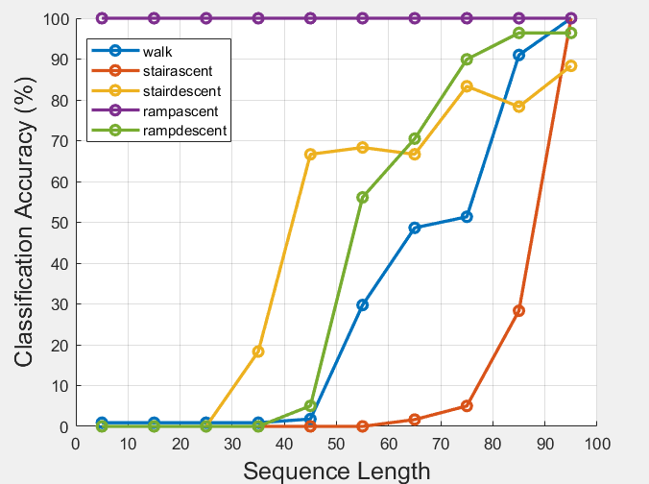
Classification Accuracy – 1D CNN Model
Testing Data | Control Subject
Notes:
Now lets more onto the 1d CNN model’s results. When evaluating the baseline model on test data—obtained through an 80-20% random split of the total dataset—the CNN model achieved an impressive accuracy of 99.63%. However, for this project, the model needed to classify a subject’s ambulation mode based on their initial movements, ensuring sufficient time to predict how the ankle should move for the remainder of the stride.
To determine the minimum percentage of a stride required for accurate classification, the trained model was tested on various sequence lengths of the control subject. As shown in the plot on the right, the model consistently misclassified all modes as ramp ascent due to its highly distinct pattern. Accuracy only improved significantly when nearly the entire stride’s data was provided, as this was when each ambulation pattern became sufficiently distinct for classification.
~50 seconds

Slide 9
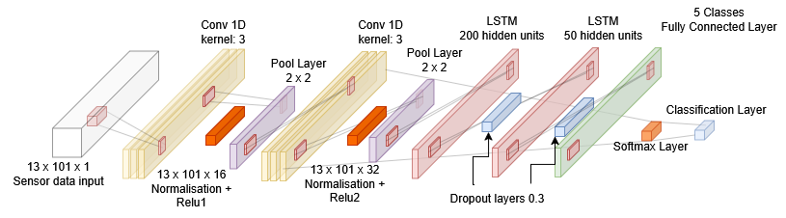
CNN-LSTM Model
Gives model short term memory to better understand temporal dependencies
Based on Lam, T et al. [7]
Notes:
Script guidance: As the next step, we wanted to further improve the model's accuracy on a reduced sequence length. After further literature review, an alternative model known as LSTM (Long Short Term Memory) was considered. Lam, T et al. Investigated the use of a network of LSTMs to aid in gait recognition and had obtained accuracies ranging from 70 - 90% which seemed promising considering the dataset being used was captured from a smartphone dataset known as whuGAIT. LSTM models excel at capturing long-term dependencies which is ideal in this case as the data is all temporally dependent. As data was already being fed sequentially into the CNN model a natural progression from this seemed to be to create a hybrid CNN-LSTM model. This was with the aim of having the benefits of both the current CNN architecture with the added benefit of the ‘memory’ of LSTM. In order to facilitate this an additional layer was added to the current CNN, comprising two LSTM layers. To facilitate this change, labels were assigned on a per time step basis.
Rough: Idea is to combine the models to account for each others weaknesses. CNN – good at recognising patterns and with spatial problems, we have spatial data as well as time series data
LSTM – Can remember previous values, great for sequential data
A CNN to LSTM model for classification, allows for more inputs (focused on upper thigh/above knee) without as much confusion for the model.
So, we extract local features from multivariable sensor data with the CNN, the temporal dependencies of these features are captured using the two LSTM layers. This outputs per-percentage-step classifications of the gait modes.
Reference https://ieeexplore.ieee.org/document/9345743

Slide 10
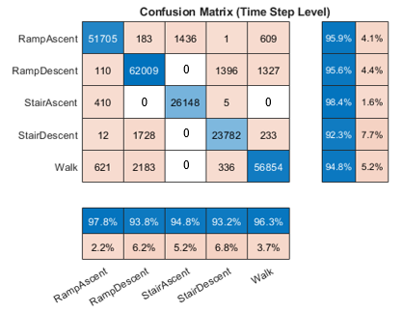
Classification Accuracy – CNN-LSTM Model
Testing Data | Control Subject
Notes:
Talk about why there might be confusion – smaller dataset for these ambulation modes, overall classification accuracy is high per time step though. This is seen clearly when compared to control subject AB14 who was removed completely from dataset, with some cases showing that even with just 5% of the stride the model can be reasonably accurate and with 10% it its over 90% accurate at identifying the ambulation mode.
Script guidance: Initial tests at lower epochs showed some initial confusion likely to the increase of label data but running this for 200 epochs gave promising results. Whilst there is still some confusion between the different locomotion modes there were a few cases of zero confusion, these cases are indicative of the difference between each of the movements. Operating on a per time step basis improved the reduced sequence length results as well. Showing up to a 98% accuracy at classifying certain movements with just 10% of the gait cycle provided. This shows great generalization in this case as these results were collected from the chosen control subject.

Slide 11
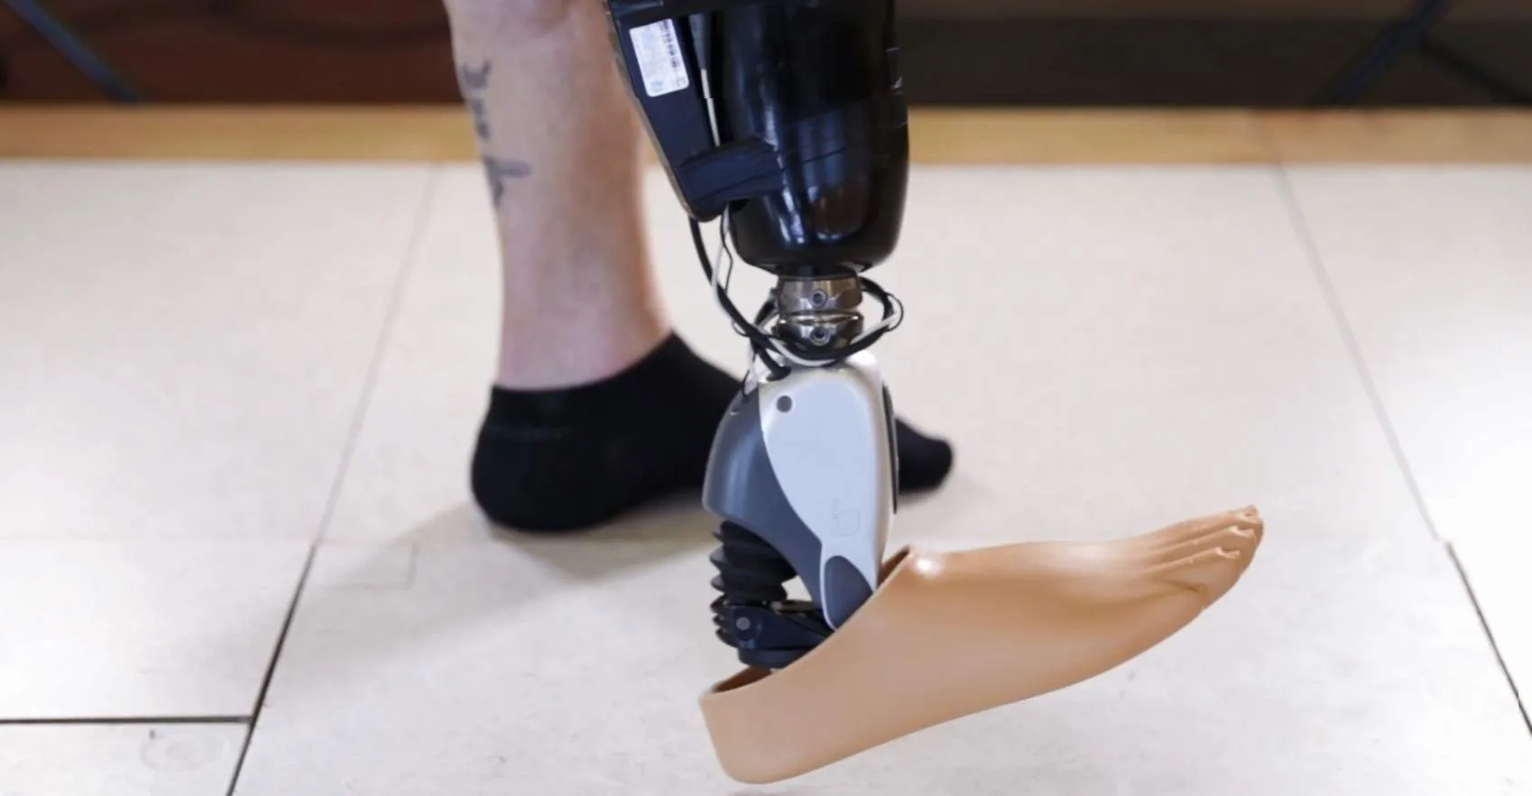
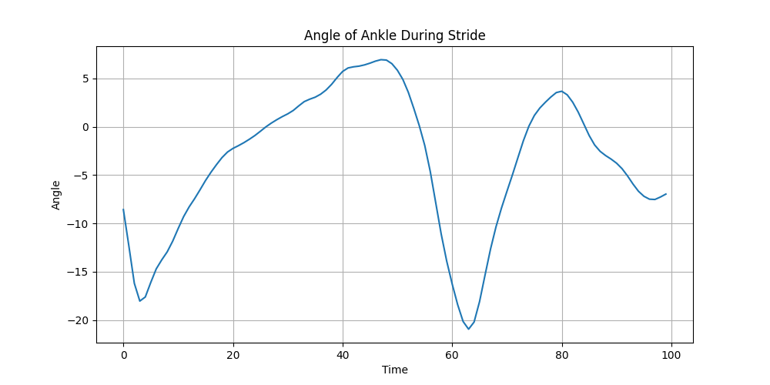
Gait Forecasting
Why would you want to predict a user’s gait?
EMG, IMU and Goniometer data received
• Reactive prosthetic legs react after force is applied, leading to jerky, delayed movements.
• This delay makes walking inefficient and increases energy expenditure for the user.
• Machine Learning can anticipate the angle the foot would naturally follow through the gait cycle.
Classifier identifies mode of locomotion
Prediction model forecasts angle of flexion
Predicted angle is sent to ankle motor
Full architecture
Notes:
Why would you want to predict a user’s gait?
In machine learning based prosthetics, predicting the users gait means you can anticipate how the foot should move, meaning there is no delay from the sensors waiting for cues on how the foot should move
This will lead to a smoother, more realistic action which requires less energy from the user as they don’t need to compensate for any irregularities in their gait.
The machine learning model can learn how a user moves, mimicking the natural pattern the users appendage would natturaly take as they move.
This prediction model would take inputs from the sensors in the prosthetic, alongside the classification of what type of locomotion is happening from the classificaiotn model.
Then it will predict the angle the ankle should take in real-time, sending this information to the motor unit wihtin the prosthetic.
https://www.google.com/search?q=bionic+foot+angle&sca_esv=180657c937ead09d&udm=2&biw=1600&bih=809&sxsrf=AHTn8zqQhv-Eg2t7pXskiG51ouEoIeHPIA%3A1742927747627&ei=g_fiZ4eFJrmphbIP177f4AY&ved=0ahUKEwjH0pDq76WMAxW5VEEAHVffF2wQ4dUDCBE&uact=5&oq=bionic+foot+angle&gs_lp=EgNpbWciEWJpb25pYyBmb290IGFuZ2xlMgcQIxgnGMkCMgcQIxgnGMkCSOoDUOwCWOwCcAJ4AJABAJgBL6ABXKoBATK4AQPIAQD4AQGYAgOgAjaYAwCIBgGSBwEzoAfyBbIHATG4BzM&sclient=img#vhid=1iDTkl-K-1agbM&vssid=mosaic:~:text=Search%20inside%20image-,Brain%2DControlled%20Bionic%20Legs%20Are%20Finally%20Here,-Visit Is the leg picture

Slide 12
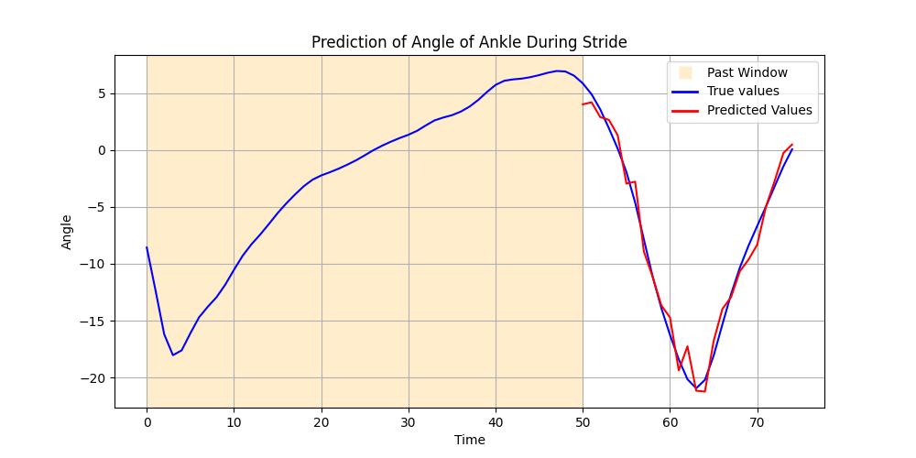
Again could condense this, Since these models are already used earlier we don’t need to justify it? Just saying we want one cohesive model or smth
LSTM & CNN for Prediction
Model | LSTM | CNN
How does it handle prediction | Learns sequential dependencies to predict future gait states. | Identifies spatial patterns in movement data to predict the next step.
Why would it be better? | Ideal for capturing temporal dependencies, and long-term trends. | Better at finding patterns despite noisy signals and capturing short-term patterns.
Past window = 50, Future window = 25
Notes:
Previously, LSTM & CNN models were used for classification, now we look at their role in prediction.
These two models were chosen to compete for 2 reasons: both are referenced in previous literature such as LUKE help me
And because the end goal for this project would be to have one cohesive model, that would be able to classify and predict the movement I DON’T KNOW ABOUT THIS
An LSTM could be useful in this task as they are very good at understanding time-dependencies, and gait signals are sequential, with the pattern of one step being influenced by the last. It would be ideal for understanding the long-term trends in the data, so if there are complex dependencies such as how a left-footed step would influence the right this would be captured.
A CNN however is suited to understanding local patterns in data, so could be able to predict the recurring patterns in the gait cycle. It should be able to discern the actual trend from any noise in the data, and understand the short term patterns in the cycle.
The hope is that having these two quite different neural nets would give us the best chance of ideally modelling the complex data.
Both models are the same in the way they will predict however, looking at a set past window of size X of sensor data, and using that to influence its prediction of the next Y steps of the angle data.

Slide 13
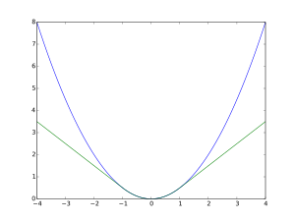
Hyperparameter Tuning & Huber Loss
To get the optimal model you want to finetune your parameters, choosing those that result in the highest accuracy
Grid Search was used to exhaustively find the optimal parameters
Huber Loss was used for training as it increased accuracy compared to MSE.
Huber Loss punishes extreme outliers less than MSE, and gait data across multiple subjects is quite noisy.
Hyperparameter | Range | Optimal for LSTM | Optimal for CNN
Past window | [10, 75] | 25 timesteps | 70 timesteps
Future window | [5 , 25] | 13 timesteps | 10 timesteps
Number of layers | [1, 2, 3] | 2 layers | 4 layers
Number of hidden nodes | [64, 128, 256, 512] | 128 | 128
MSE in blue, Huber Loss in green
Quadratic up to X=1
Notes:
Hyperparameter tuining is an important part of any machine learning model, choosing the values for parameters that maximise the models accuracy.
The parameters in both models that lead to the most variabiltiy when tweaked were past and future windows. Architectural parameters like number of layers for the models and hidden dimension were also optimised which lead to big improvements.

Slide 14
Performance Metric
Huber Loss
Huber Loss is a function that behaves like MSE for small errors, and MAE for large errors.
Huber Loss was used for training as it increased accuracy compared to MSE.
This could be as Huber Loss punishes extreme outliers less than MSE, and gait data across multiple subjects is quite noisy.
MSE in blue, Huber Loss in green
Quadratic up to X=1
Notes:
Commonly machine learning models will use loss functinos like mean squared error to penalise errors. However this can significantly penalise outliers, and in a dataset with so much variation this led to sub-optimal perforamnce.
Huber loss is a function that behaves like mean square error for small errors, with a quadratic curve up to a set point.
Then it behaves like the absolute error function for larger values, with a linear loss curve.
This improved the accuracy in both models greatly.

Slide 15
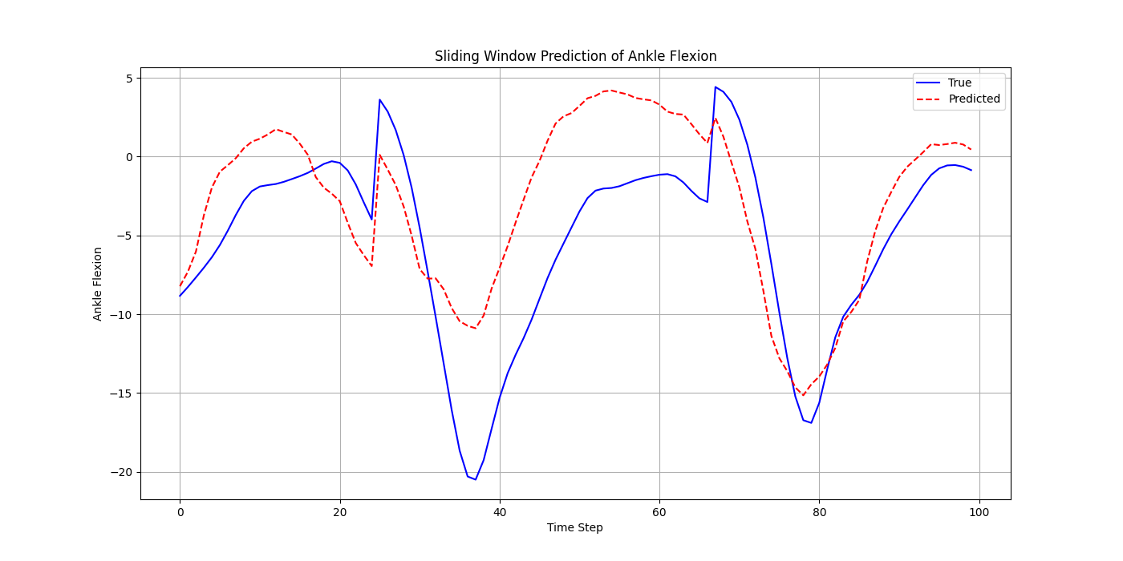
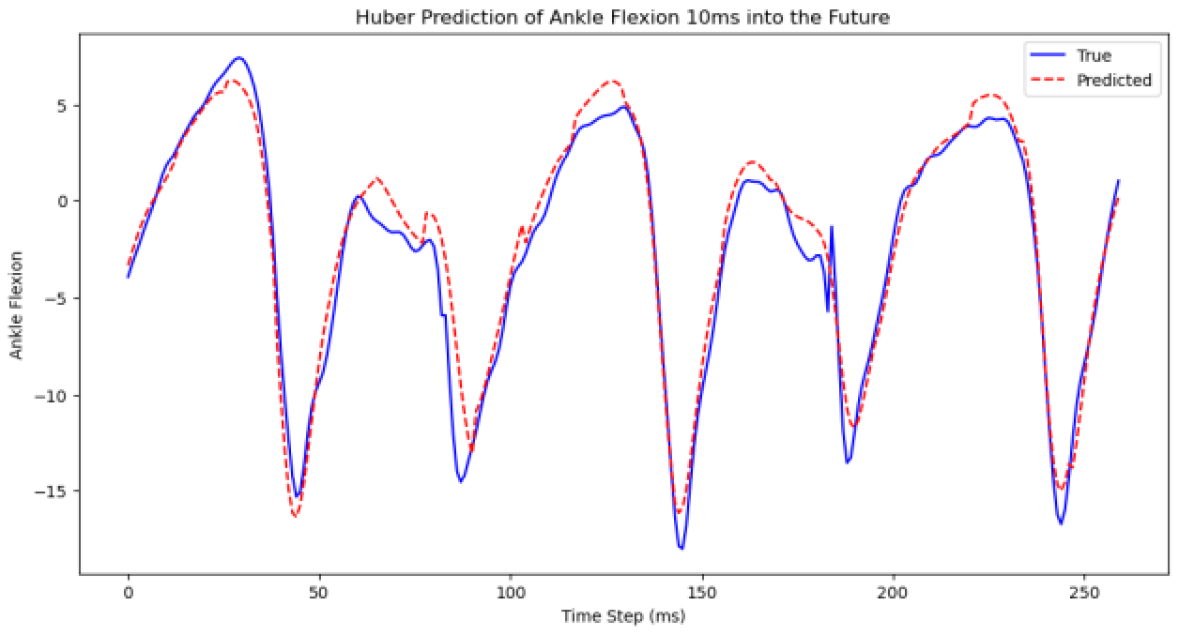
Prediction – deciding which one - Alastair
LSTM vs CNN?
LSTM results
CNN results
Nulla a erat eget nunc hendrerit ultrices eu nec nulla. Donec viverra leo aliquet, auctor quam id, convallis orci.
Sed in molestie est. Cras ornare turpis at ligula posuere, sit amet accumsan neque lobortis.
Maecenas mattis risus ligula, sed ullamcorper nunc efficitur sed.

Slide 16
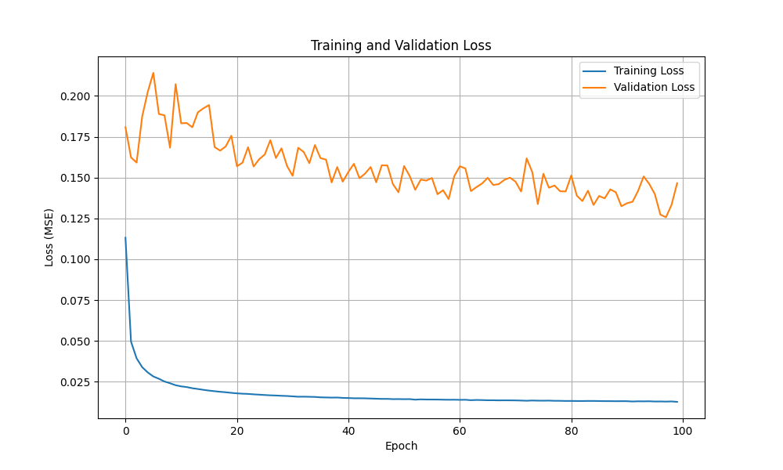
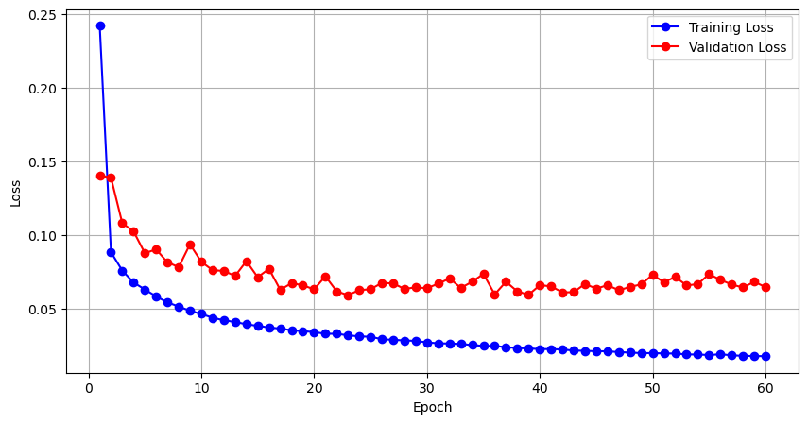
Comparative Performance
Training loss and accuracy of classification model – Show predicted values vs actual
LSTM results
CNN results
Include the huber loss here if we want

Slide 17
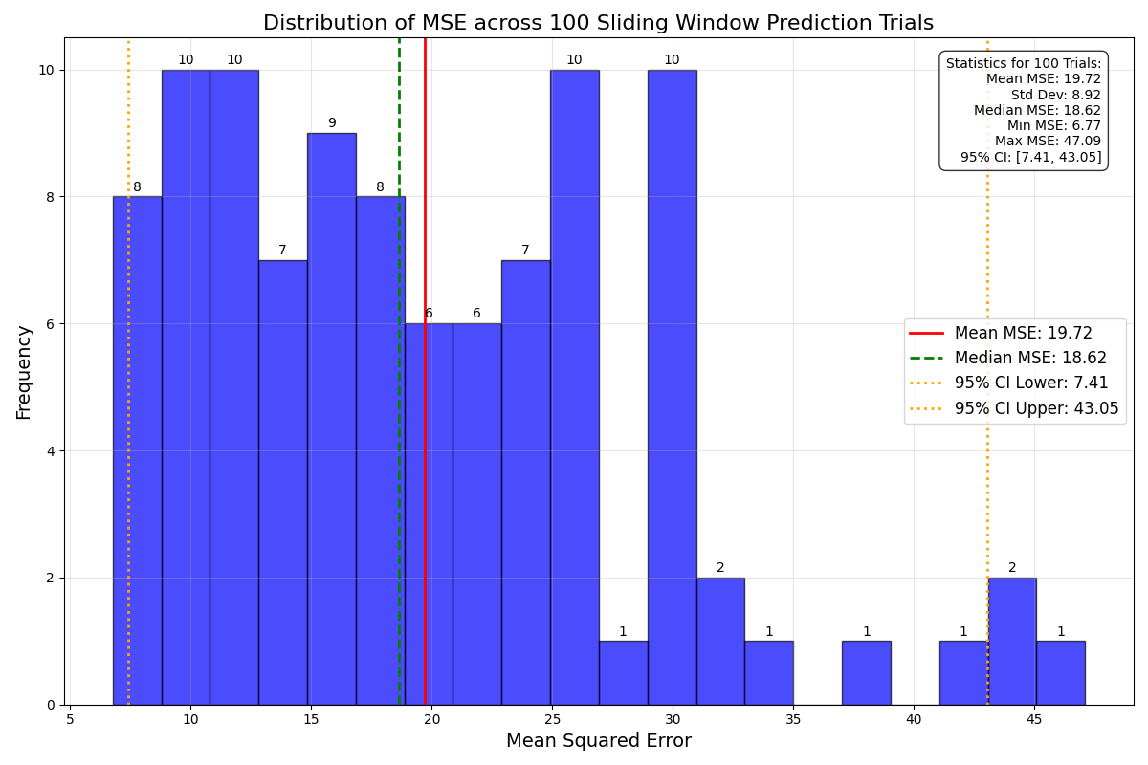
Prediction Results
Who won? A plot each for the random 100 trial, and a plot overlayed for a random AB14 one
LSTM results
CNN results
Notes:
It is clear that both of the models are prone to overfitting. However the validation loss of the LSTM converges fairly quickly and to a lower value than that of the CNN, indicating that it may generalize better on unseen data.
To test each model’s generalizability and obtain comparable performance metrics for both models, each model was tested over 100 different trials of predicting 260 timesteps into the future, with each trial starting at a different random point determined by a random seed. The MSE of each trial was then calculated to find the average MSE over all 100 trials. MSE heavily punishes predictions that are far away from the ground truth. Therefore calculating the MSE over many different trials that take place on different gait cycles allows us to measure which model is capable of making less significant errors, which could result in the user suffering an injury from the prosthetic pre empting an incorrect gait.
We found that the *INSERT MODEL* had an average MSE of *INSERT MSE VALUE* and the *INSERT OTHER MODEL* had an MSE of *INSERT OTHER MSE VALUE*. From the distribution of the MSE of each trial we can see how often each model is prone to making significant errors. In this case the CNN model is rarely predicting the gait precisely but is not making significant errors very often, with only 5 of the 100 trials having an MSE of 35 or greater. *Insert something about the LSTM here*.

Slide 18
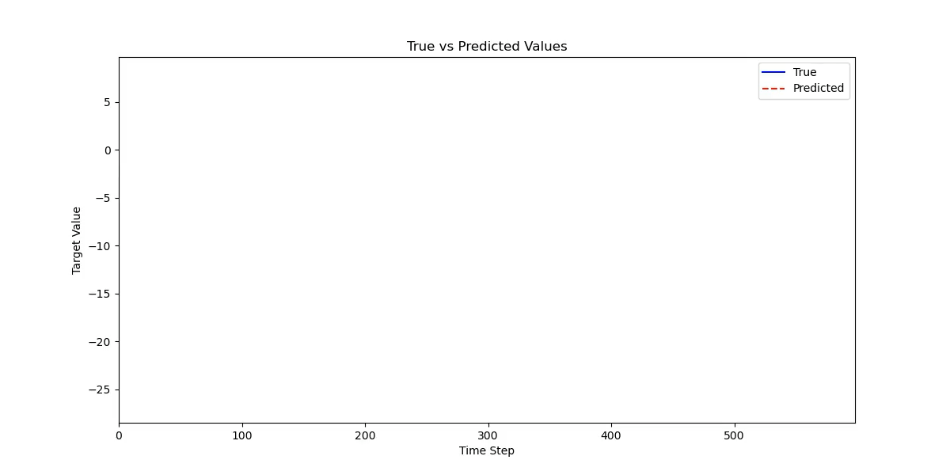
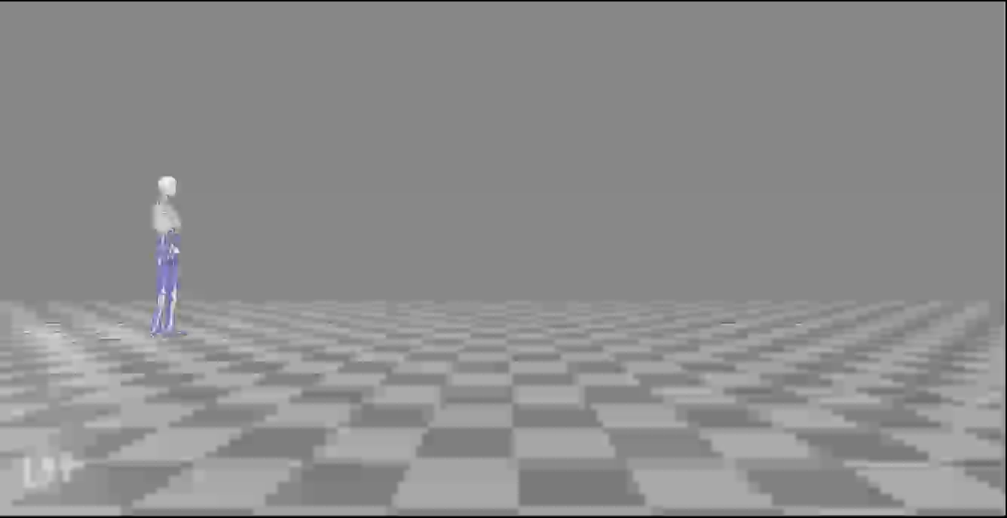
Visualisation
The visualisation of simulated walking and real-time prediction
Notes:
Narration of video:
So here is a visualisation of the final model working in real-time.
We have simulated the test subject AB14 moving around the space. Our classification model identified it as walking after 10% of the first stride, with the real-time true and predicted values being plotted on the right.

Slide 19
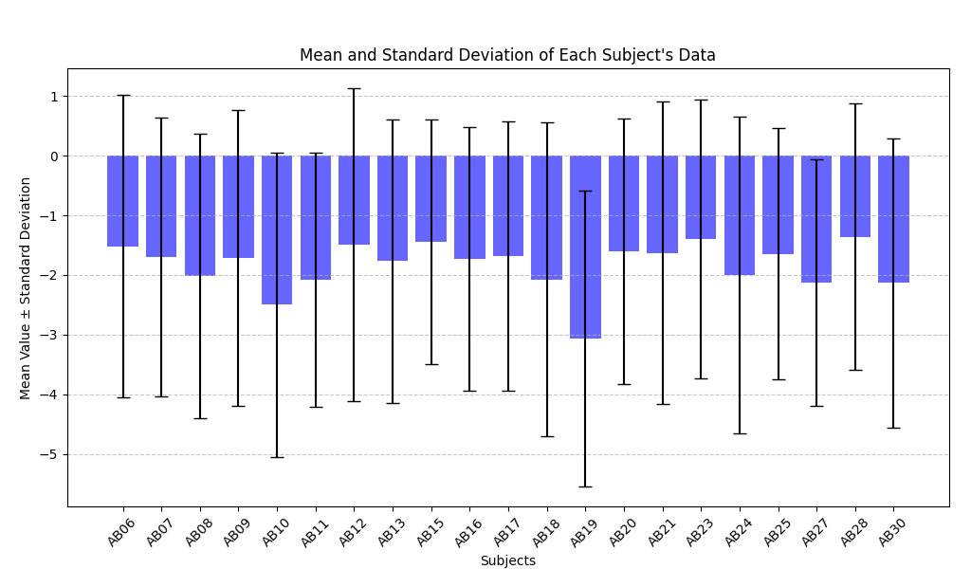
Challenges
Lots of variation in the dataset
Metadata not included
Only 13 dimensions due to sensor selection
Overparameterisation leads to overfitting
Slight confusion during classification training
Small amount of usable data, treadmill was the most abundant.
Notes:
Combining dataset: Compiling the data from all 21 subject can lead to large differences in the model.
Without including the metadate, height etc, the model struggles
Future work: Performing sVDon individual models for each subject can reveal the common parameters, making a general model.
To tackle this problem future work would be training a separate model on each of the subjects, and then performing single vector decomposition on the weights and biases form each model. From this you could extract all the parameters that are common between the subjects and form a general model. The parameters that are different between them would act as the ones you would tweak when using this model on a new subject, as these would likely encode the data that varies between people.
The dataset is bounded by how many sensors we can realistically use. Neural nets are used to working in high dimensional space, however our dataset is only 13 dimensions. This will lead to overparameterisation, meaning the model will tend to overfit during training, learning the noise rather than the underlying trends. Potential future work could attempt ARIMAX multivariate time series forecasting, as this is lelss overkill than a whole neural net as it uses far fewer parameters.

Slide 20
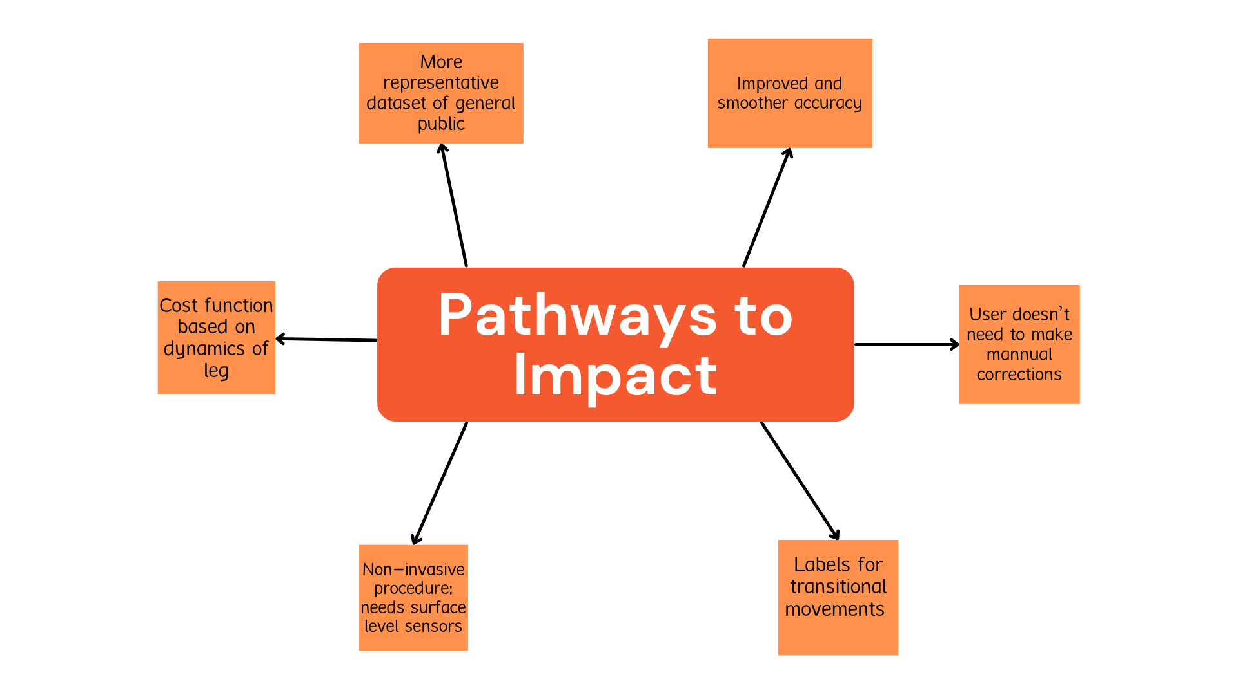

Notes:
Our work provides the groundwork and demonstrates the proof of concept for predictive prosthesis control but further refinements need to be made.
Currents results are decent but not ideal for controlling a real world prothesis due to their jaggedness. For future work we would implement a cost function that is more representative of the dynamics involved. One such model can be found here (https://www.researchgate.net/publication/353447376_A_Mathematical_Model_of_The_Human_Lower_Limb_During_a_Complete_Gait_Cycle_and_Its_Various_Phases)
A more varied dataset could be utilised. Currently we have 22 subjects all considered healthy. Future datasets could incorporate younger or older subjects. Subjects with neurological/physical defects to improve generalisation.
Enhanced labels, potentially include transitory states into labels such as going from stand to walk or vice versa.
Non-invasive procedure, just needs surface level sensors.
Improved quality of life due to pre-emptive nature of model, user doesn’t have to do manual corrections etc.

Slide 21
References
[10] Dataset used: Camargo, J., Ramanathan, A., Flanagan, W. and Young, A., 2021. A comprehensive, open-source dataset of lower limb biomechanics in multiple conditions of stairs, ramps, and level-ground ambulation and transitions. Journal of Biomechanics, 119, p.110320.
[1]: Nasr, A, Laschowski, B, & McPhee, J. "Myoelectric Control of Robotic Leg Prostheses and Exoskeletons: A Review." Proceedings of the ASME 2021 International Design Engineering Technical Conferences and Computers and Information in Engineering Conference. Volume 8A: 45th Mechanisms and Robotics Conference (MR). Virtual, Online. August 17–19, 2021. V08AT08A043. ASME. https://doi.org/10.1115/DETC2021-69203
[2]: B. E. Lawson, J. Mitchell, D. Truex, A. Shultz, E. Ledoux and M. Goldfarb, "A Robotic Leg Prosthesis: Design, Control, and Implementation," in IEEE Robotics & Automation Magazine, vol. 21, no. 4, pp. 70-81, Dec. 2014, doi: 10.1109/MRA.2014.2360303.
[3]: Su, Binbin, and Elena M. Gutierrez-Farewik. 2020. "Gait Trajectory and Gait Phase Prediction Based on an LSTM Network" Sensors 20, no. 24: 7127. https://doi.org/10.3390/s20247127
[4]: R. Kolaghassi, G. Marcelli, and K. Sirlantzis, “Deep learning models for stable gait prediction applied to exoskeleton reference trajectories for children with cerebral palsy,” IEEE Access, vol. 11, pp. 31962–31976, 2023, doi: 10.1109/ACCESS.2023.3252916.
[5]: Semwal, V.B., Jain, R., Maheshwari, P. et al. Gait reference trajectory generation at different walking speeds using LSTM and CNN. Multimed Tools Appl 82, 33401–33419 (2023). https://doi.org/10.1007/s11042-023-14733-2
[6]: Jeffrey Berning, Gerard E. Francisco, Shuo-Hsiu Chang, Benjamin J. Fregly, Marcia K. O'Malley, Myoelectric control and neuromusculoskeletal modeling: Complementary technologies for rehabilitation robotics, Current Opinion in Biomedical Engineering, Volume 19, 2021,100313, ISSN 2468-4511,https://doi.org/10.1016/j.cobme.2021.100313.
[7]: L. Tran, T. Hoang, T. Nguyen, H. Kim and D. Choi, "Multi-Model Long Short-Term Memory Network for Gait Recognition Using Window-Based Data Segment," in IEEE Access, vol. 9, pp. 23826-23839, 2021, doi: 10.1109/ACCESS.2021.3056880. https://ieeexplore.ieee.org/document/9345743
[8]: Cimolato, A., Driessen, J.J.M., Mattos, L.S. et al. EMG-driven control in lower limb prostheses: a topic-based systematic review. J NeuroEngineering Rehabil 19, 43 (2022). https://doi.org/10.1186/s12984-022-01019-1

Slide 22
Image credits
[A]: Nelson (n.d.) A person walking with a robotic exoskeleton suit assisting in rehabilitation and mobility. AI-generated image. Adobe Stock. Available at: https://stock.adobe.com/uk/search?k=exoskeleton&asset_id=732867307
[B]: Karadsheh, M., 2021. Gait Cycle. Orthobullets. Available at: https://www.orthobullets.com/foot-and-ankle/7001/gait-cycle [Accessed 14 Mar. 2025].
[C]: Cimolato, A., Driessen, J.J.M., Mattos, L.S. et al. EMG-driven control in lower limb prostheses: a topic-based systematic review. J NeuroEngineering Rehabil 19, 43 (2022). https://doi.org/10.1186/s12984-022-01019-1
[D]: Peerdeman, Bart, Daphne W. Boere, Heidi J. B. Witteveen, Rianne Huis in 't Veld, Hermie J. Hermens, Stefano Stramigioli, Hans S. Rietman, Peter H. Veltink and Sarthak Misra. “Myoelectric forearm prostheses: state of the art from a user-centered perspective.” Journal of rehabilitation research and development 48 6 (2011): 719-37 .
[E]: Camargo, J., Ramanathan, A., Flanagan, W. and Young, A., 2021. A comprehensive, open-source dataset of lower limb biomechanics in multiple conditions of stairs, ramps, and level-ground ambulation and transitions. Journal of Biomechanics, 119, p.110320.

